Slide 1
Managing Diversity at workplace
Cdr. Vijay Pratap Singh
Adjunct Professor, E&TC
TCET

Slide 2
Diversity:
The concept of diversity is based on individual acceptance and respect.
It is an understanding that individuals are unique and different.
Cultural diversity
Cultural diversity acknowledges the existence of broad cultural groups within Indian culture.
Cultural diversity has been part of India's history, and through it, India culture is constantly developing.

Slide 3



Elements of Diversity
Age
Gender
Ethnicity
Race
Physical Ability
Sexual Orientation
Physical Characteristics
Income
Education
Marital Status
Religious Beliefs
Geographic Location
Parental Status
Personality Type

Slide 4
Ways to incorporate diversity:
Businesses find ways to incorporate diversity into their workplaces without causing major changes to the way their companies operate.
Incorporating diversity practices in a workplace can include
Recruiting from diverse talent pools to make the company open to employees from various backgrounds.
Diversity may be infused into advertising practices to ensure products and services are targeted to all consumers who represent the target market, whether through print, online, television or radio.

Slide 5
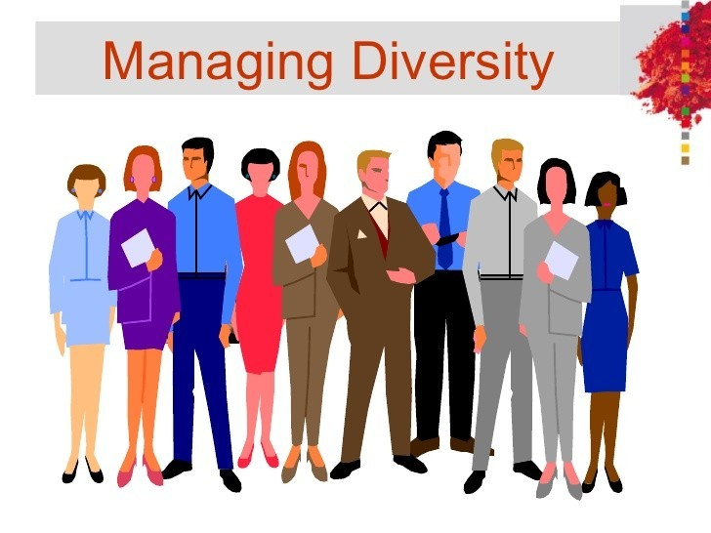
Managing Diversity is defined has the “planning and implementing organizational systems and practices to manage people so that the potential advantages of diversity are maximized while its potential disadvantages are minimized”.

Slide 6
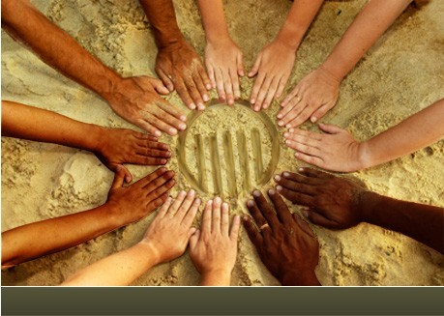
Multiculturalism
Multiculturalism is a system of beliefs and behaviors that recognizes and respects the presence of all diverse groups in an organization or society, acknowledges and values their socio-cultural differences, and encourages and enables their continued contribution within an inclusive cultural context which empowers all within the organization or society.

Slide 7
Key to growth:
Diversity management is the key to growth in today’s fiercely competitive global marketplace.
No longer can America’s corporations hide behind their lack of cultural intelligence.
Organizations that seek global market relevancy must embrace diversity – in how they think, act and innovate.
Diversity can no longer just be about making the numbers, but rather how an organization treats its people authentically down to the roots of its business model.
In today’s new workplace, diversity management is a time- sensitive business imperative.

Slide 8
The Future of Diversity:
To better understand the future of diversity management and its role as a business growth enabler, think back to when Information Technology (IT) was viewed as just a cost center.
IT was not associated with driving business growth 20 years ago, but rather as a required cost of doing business.
Just like diversity today, many people then thought IT got in the way of business. Today, IT is considered a profit center by many and a high priority for organizations as a business growth
enabler.
In fact, many CIOs (Chief Information Officers) are next in line for the CEO role. As a result, to be an influential CIO; you must be a business strategist with an MBA (not just a computer science degree).

Slide 9
Contd…
Diversity management will begin to develop rapidly, out from under the traditional human resources and talent acquisition roles, to assume more dotted-line responsibilities that will touch corporate strategy, corporate social responsibility, organizational design & effectiveness, corporate marketing and even sales.
Therefore, the requirements to be an effective CDO will mean that they must include operating more holistically in a general management and operational capacity to ensure that diversity becomes an embedded mindset with common threads that touch all functional areas (internally) and the supply chain (externally).

Slide 10
If we could shrink the earth's population to a village of precisely 100 people, with all the existing human ratios remaining the same, it would look like this. There would be:
61 Asians
12 Europeans
14 from the Western Hemisphere, both north and south
13 Africans
50 would be female
50 would be male
74 would be nonwhite
26 would be white
67 would be non-Christian
33 would be Christian
89 would be heterosexual
11 would be homosexual
6 people would possess 59% of the entire world's wealth and all 6 would be from the United States
80 would live in substandard housing
14 would be unable to read
33 would die of famine
1 would be near death;
1 would be near birth
7 would have a college education
8 would own a computer

Slide 11
Women in the Workplace:
The need to understand diversity is also driven by women in the workplace.
Today's workforce has the highest levels of employment participation ever by women.
The number of dual income families and single working mothers has increased.
Change in the family structure means that there are fewer men and women in traditional family roles.
Therefore, diversity issues cut across both race and gender.

Slide 12
How Diversity Initiatives Help an Organization Keep a Competitive Human Resources Advantage
Improves corporate culture
Improves employee morale
Easier recruitment of employees
Enables the organization to move into emerging markets
Increases creativity
Access to overseas markets.
Reduction in skill shortages.
Decreased interpersonal conflict among employees
Improves client relations
Increases productivity
Improves the organization`s bottom line
Maximizes brand identity
Responsive service delivery and enhanced staff skills

Slide 13
Benefits of Diverse workplace:
Customer service improves when staff understand and can communicate skillfully with customers from a range of backgrounds.
The community is also more likely to identify with and relate to companies that reflect its level of diversity
Workplace diversity where staff are encouraged to work in their areas of strength and capability.
Valuing diversity where staff potential is recognized and developed.
Productive diversity is valuing different experience, perspectives, skills and the cross-transfer and integration of these into the company and local economy.

Slide 14
Possible Barriers
Limiting area of consideration
Lack of diverse applicant pool in STEM positions
Lack of diversity at the senior ranks
Categorizing people into certain positions
Always recruiting from same source
Grooming/developing only one person
Pre-selection
●

Slide 15
How to Manage Diversity
Steps in Managing Diversity Effectively
Secure top management commitment
Alternative work arrangements
Increase diversity skills
Organizational assessment
Attracting employees
Accommodating work and family needs

Slide 16
Diversity Awareness Programs
Provide members with accurate information about diversity
Uncover personal biases and stereotypes
Assess personal beliefs, attitudes, and values and learning about other points of view
Develop an atmosphere in which people feel free to share their differing perspectives
Improve understanding of others who are different
5-16

Slide 17
Consequences of Ignoring Diversity:
Ignoring diversity issues costs time, money, and efficiency.
Some of the consequences can include
Unhealthy tensions between people of differing gender, race, ethnicity, age, abilities, etc.;
Loss of productivity because of increased conflict;
Inability to attract and retain talented people of all kinds;
Complaints and legal actions;
Inability to retain women and people of color, resulting in lost investments in recruitment and training.

Slide 18
Considerations and Warnings:
As workplaces become more diverse, employers are encouraged to take note of communication, training, recruiting practices and management.
Diverse workforces may be plagued with problems if employees aren't equipped with the knowledge they need to communicate effectively with their coworkers, regardless of their differences.
Diversity training can help reduce interpersonal conflicts within a company. As a result of efforts to train employees on diversity issues, management may see an increase in training and development costs.
Allbusiness.com, an online resource for entrepreneurs, notes some businesses believe that costs of diversity are higher than its benefits because of potential issues with communication and training.

Slide 19

Example 1: Coca-cola Company
Diversity is at the heart of our business.
We strive to create a work environment that provides all our associates equal access to information, development and opportunity.
By building an inclusive workplace environment, we seek to leverage our global team of associates, which is rich in diverse people, talent and ideas.
We see diversity as more than just policies and practices.
It is an integral part of who we are as a company, how we operate and how we see our future.

Slide 20
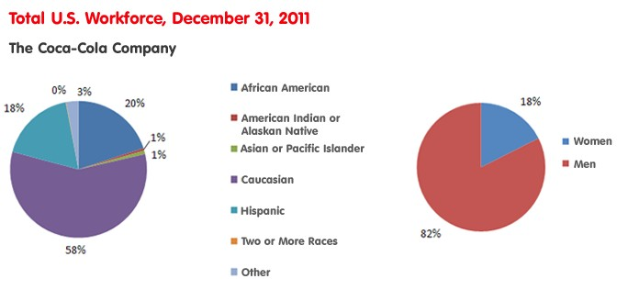
Contd…
As a global business, our ability to understand, embrace and operate in a multicultural world -- both in the marketplace and in the workplace -- is critical to our long-term sustainability and, specifically, impacts our ability to meet our 2020 Vision People goals.
Many people across the company continue to work diligently to help us advance in our diversity journey and build our practices on diversity, inclusion and fairness.

Slide 21
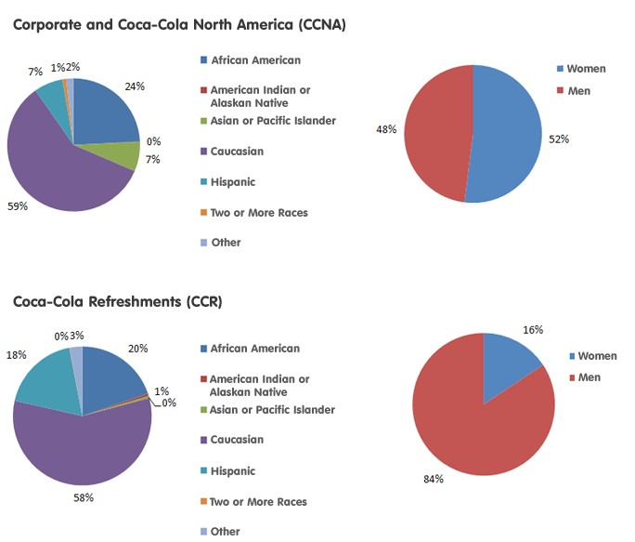
Contd…

Slide 22

Equation of the company:
We also include our associates in the process. We garner their feedback through formal surveys and informally through their participation in our business resource groups, various diversity education programs and our Resolution Resources Program, where associates can work to resolve issues they face in our Company.

Slide 23


A French tiling and flooring company with 42 people as workforce.
Was facing difficulties in recruiting local work force.
Wanted a more diverse workforce.
Following complaints about workers not being serious it recruited more women and young people from deprived areas.

Slide 24

Suspected reason was discrimination.
One day full training regarding -
Power of stereotypes
Benefits of diversity
Problems were surprisingly resolved. Employees were more-
Efficient
Independent
Motivated
Unexpected outcome-
Friendship emerged between workers from very different backgrounds.

Slide 25
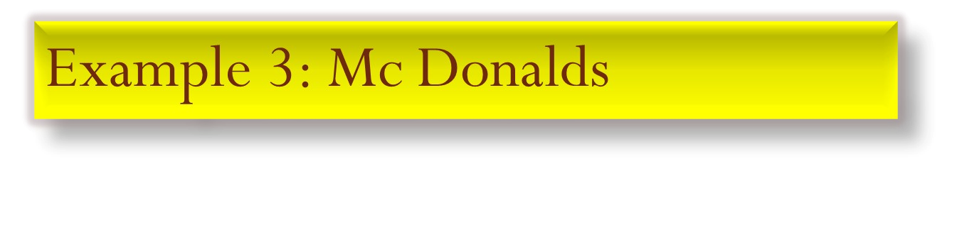

Well known for diversity.
62000 people from 128 countries.
Believes in equal chance and offers to all its employees.
Partnerships with community colleges all over Germany.
Employees improve communication skills as well as IT knowledge.
This enables everyone in the diverse workforce to grow and climb up the corporate ladder.

Slide 26
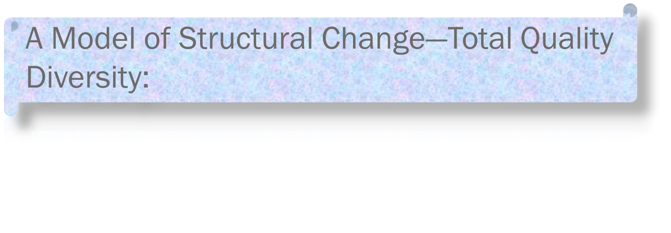
Total Quality Diversity (TQD) is a holistic model of managing diversity that operates on two levels:
The Horizontal—the individual interactional change dimension; and
The Vertical—the institutional structural change dimension .
Both factors are driven by the bottom line profit motive, to help businesses deliver a quality product—employees are prepared to meet human needs in a competitive global economy.
Structural change: Values, education
Interactional change: Age, gender
❖
❖
Institutional inclusion: Disability, ethnicity
Individual inclusion: Culture, occupation

Slide 27
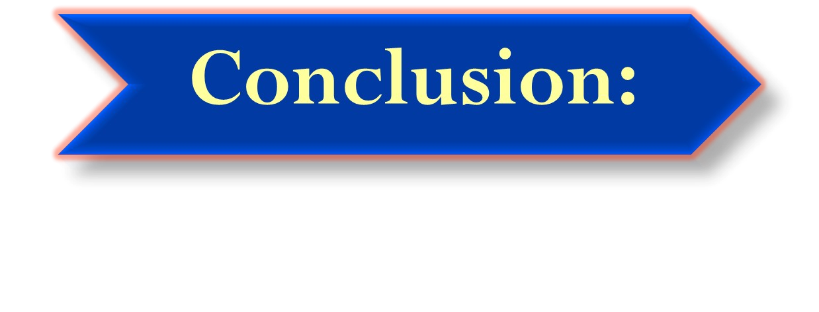
A diverse workforce is a reflection of a changing world and marketplace.
Diverse work teams bring high value to organizations.
Respecting individual differences will benefit the workplace by creating a competitive edge and increasing work productivity.
Diversity management benefits associates by creating a fair and safe environment where everyone has access to opportunities and challenges.
Management tools in a diverse workforce should be used to educate everyone about diversity and its issues, including laws and regulations.
Most workplaces are made up of diverse cultures, so organizations need to learn how to adapt to be successful.

